Slide 1
Functions Continued
Front-End Web Development

Slide 2
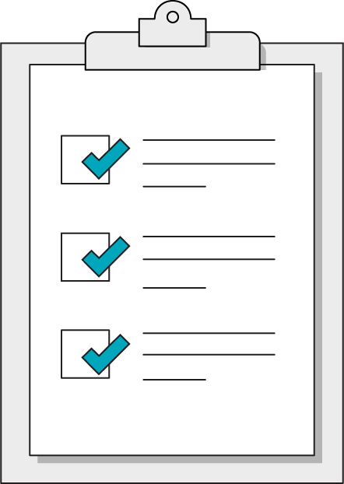
Today’s Learning Objectives
In this lesson, you will:
Apply our knowledge of functions and DOM manipulation.
Practice using DOM methods to respond to user actions with event listeners.
Review git and prepare for our final project
‹#› | © 2020 General Assembly
Notes:
DURATION: 1 minute
TEACHING TIPS:
Learning objectives help frame the lesson and give students an idea of what to expect and focus on.
Explain to students how this lesson fits into the overall course to help them make connections with content from other lessons.

Slide 3
Review of Git
Front-End Web Development

Slide 4
Git Commands
Command | Explanation
init | Creates a repository in the current directory (folder).
add | Stages the specified files to prepare them for a commit.
commit | Saves the current state of the repository.
push | Sends local repository contents to a remote repository.
clone | Downloads a remote repository onto your local machine.
pull | Syncs one version of a repository with another.
Notes:
TEACHING TIPS:
There’s a lot about GitHub that will be confusing at first. Demonstrating each of these steps and writing them on the board in sequence as a “cheat sheet” should be very helpful.

Slide 5
A Few Pieces of JavaScript
Front-End Web Development

Slide 6
A Bit of Randomness
Math.random() creates a random number between 0 and 1.
Methods:
let random = Math.random();
Notes:
TALKING POINTS:
Open DevTools and type in the word “document” to see what’s returned.

Slide 7
Prepare Strings for Comparison
Before comparing strings, it’s often necessary to clean and standardizes them.
Methods:
toLowerCase() // converts to lowercase toUpperCase() // converts to uppercase trim() // Removes spaces at start or end
Notes:
TALKING POINTS:
Open DevTools and type in the word “document” to see what’s returned.

Slide 8
Default and Preventing It
When you click on a link or submit a form the browser has a default action.
What if we don’t want the default?
Stopping Default:
addEventListener('click',function(e){
e.preventDefault();
}
Notes:
TALKING POINTS:
Open DevTools and type in the word “document” to see what’s returned.

Slide 9
Code Alongs
Front-End Web Development

Slide 10
Mood Swings
Let’s make a digital mood-ring. For each of the words input, change the display to excited, happy, or bad.
Starter code:
https://drive.google.com/drive/folders/1fGLFWb_ZEB291tRbNZ6ZDrTYSyoi9i5J?usp=sharing
Solution code:
https://drive.google.com/drive/folders/1fGLFWb_ZEB291tRbNZ6ZDrTYSyoi9i5J?usp=sharing
Notes:
To walk the students through this, you’ll need to introduce parseFloat and parseInt

Slide 11
Rock Paper Scissors
When we introduced programming, we created the logic to play rock, paper, scissors. Let’s turn it into code!
Starter code:
https://drive.google.com/drive/folders/1VtsGekb-unsIoDN3ZW1kGQudDAMCxpqc?usp=sharing
Solution code:
https://drive.google.com/drive/folders/1BiOIWRASjoiBX59ki8rpznrvlSzvM_mx?usp=sharing
Notes:
To walk the students through this, you’ll need to introduce parseFloat and parseInt

Slide 12
Enrichment: Conjunction Function
Enrichment Exercise! Check to see if a conjunction is available and then log it.
Starter code:
https://drive.google.com/drive/folders/1pDwISv59ineaoY-XWs7rPOAv5dHTMtB4?usp=sharing
Solution code:
https://drive.google.com/drive/folders/1pDwISv59ineaoY-XWs7rPOAv5dHTMtB4?usp=sharing
Notes:
To walk the students through this, you’ll need to introduce parseFloat and parseInt

Slide 13
Final Projects
Front-End Web Development

Slide 14
Final Project
HTML
CSS
JavaScript
Demonstrate a solid understanding of appropriate HTML tag use.
Create relevant layouts and efficient styling.
The page must have at least some interactive element that requires JavaScript to demonstrate mastery of the subject.

Slide 15
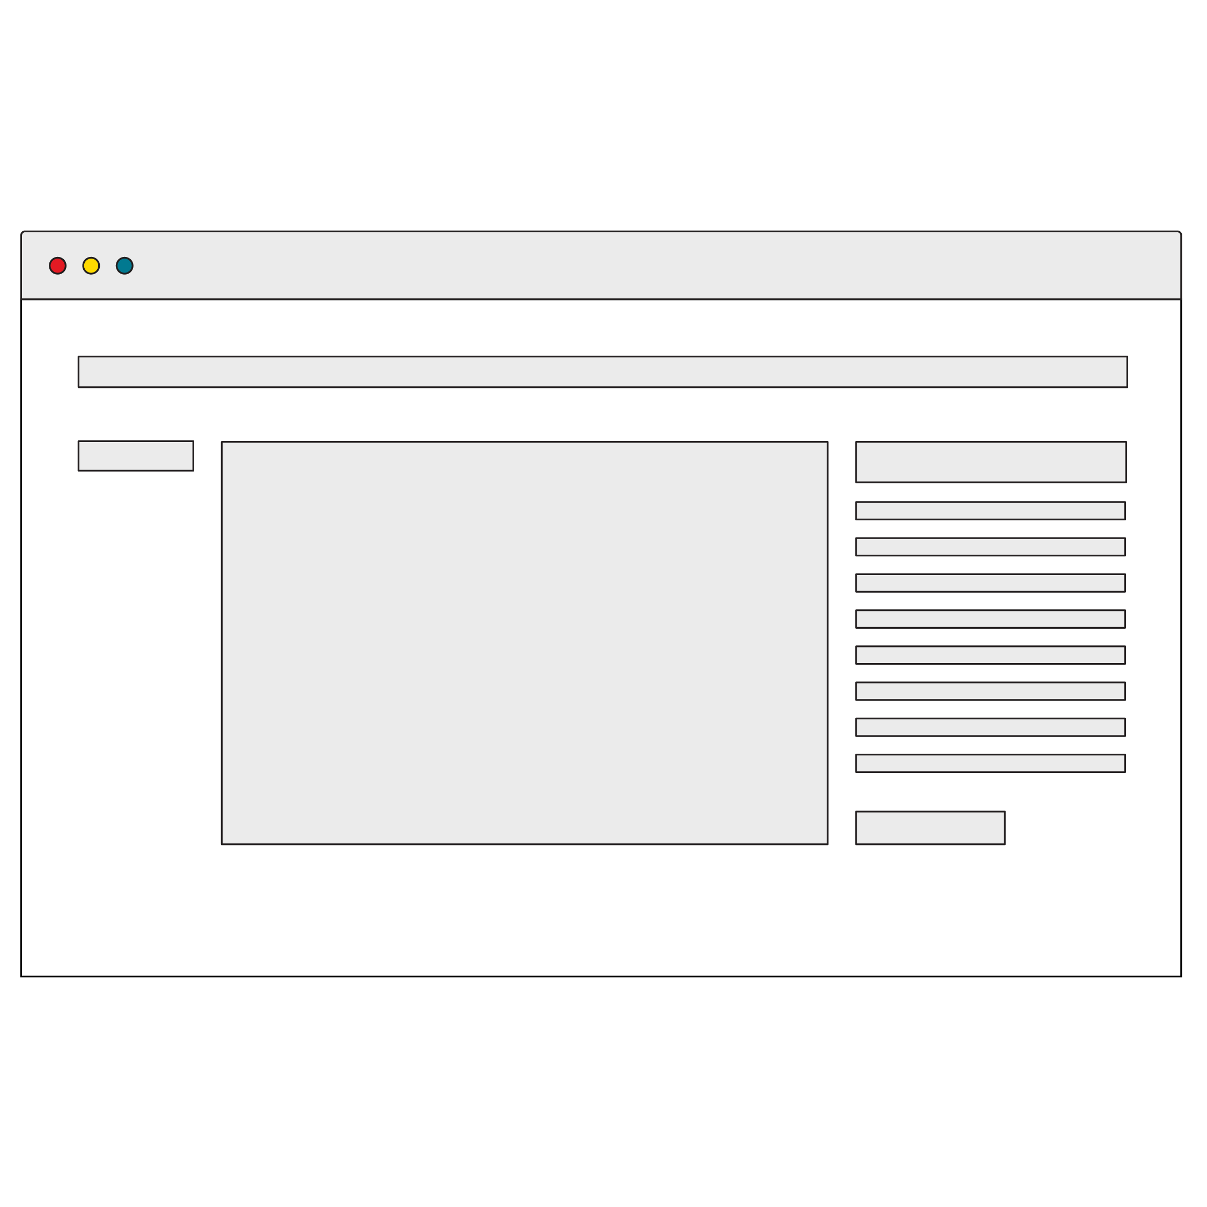
Homework 05 - Final Project Wireframes
Plan out the content of your project
Break your project into discrete page templates
Create a wireframe for each template
Note: Wireframes should be low-fidelity
Notes:
TALKING POINTS:
Open DevTools and type in the word “document” to see what’s returned.

